Slide 1
Virginia State Police Firearms Transaction Center
New Online SP65 Electronic Form
Firearms VCheck – Online SP65 E-Form

Slide 2
Advantages of using New Online SP65 E-Form
Dealer will not need to submit a request for new SP65 form.
Dealer will not have to mail in the physical copy of SP65 form at
the end of week.
Dealer will not have to fax in the SP-65 of denied transactions.
Dealer will not have to re-enter the data into VCheck system.
SP65 Electronic form will reduce errors on data entry &
non-compliance issues, which will provide for faster service.

Slide 3
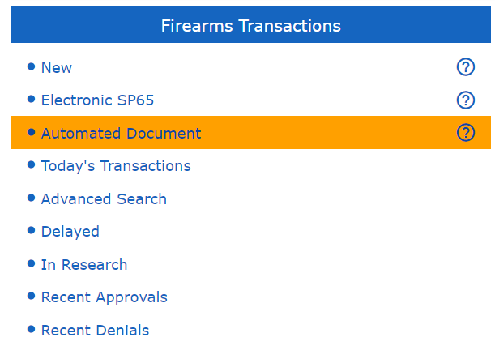
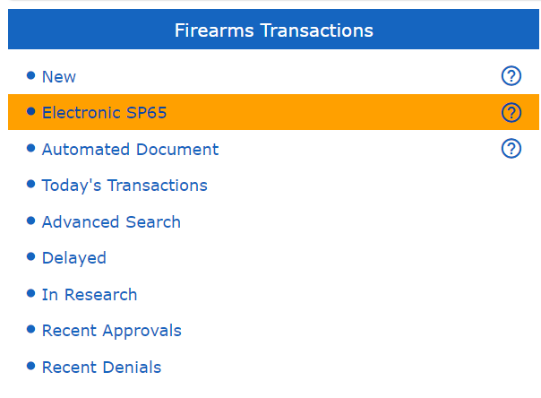
In 2016, we introduced an automated SP-65 form by selecting the “Automated Document ” link from the VCheck Home Screen.
In 2021 we introduced an electronic SP-65 form by using the “Electronic SP-65” link from the VCheck Home Screen.

Slide 4
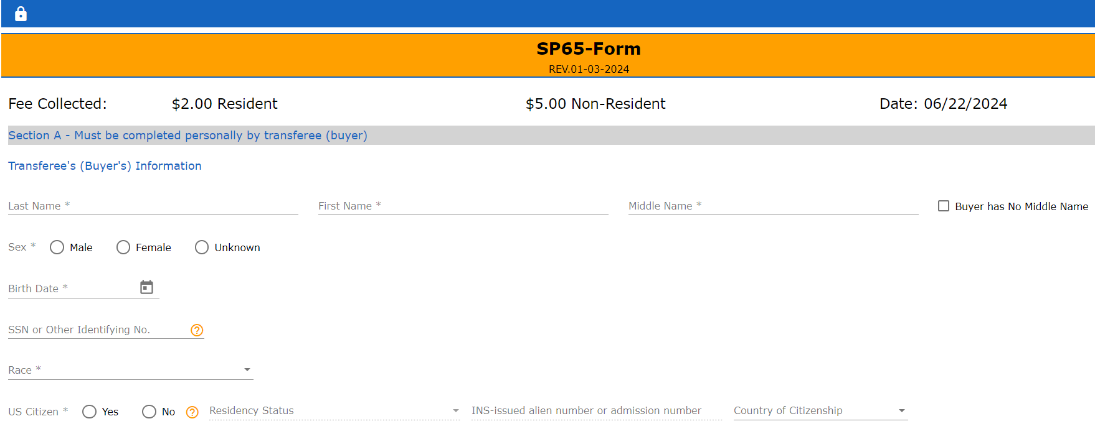
After clicking “Acknowledge”, a fillable electronic SP-65 form in VCheck system is displayed. “Section A” must be filled by the customer.
System does not allow Buyer to navigate away from this page without Seller entering login password.

Slide 5
On selection “No” for “US Citizen” field , it will give an option to select “Residency Status”

Slide 6
When selected “Residency Status” field as “Permanent Resident”, on “INS Number” field it will prefill with “A” (alien)
When selected “Residency Status” field as “Non-Immigrant”, on “INS Number” field it will prefill with “I94”

Slide 7
If Customers answer to a question triggers a disqualification, an error message is displayed. If customer wants to see an explanation of the question, click on the “?” icon
After completing “Section A”, the customer will click on the “Next button.

Slide 8
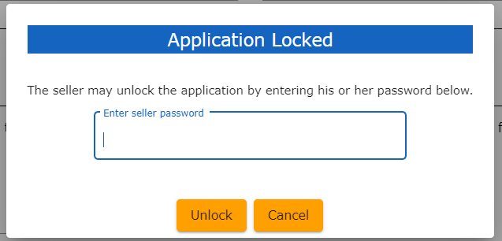
Seller must enter their login password to continue and select the “Unlock” button. If Seller selects “Cancel” button, popup will disappear and return to previous screen.en)

Slide 9
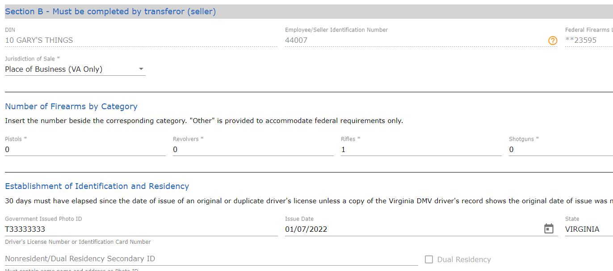
On page load, “Section B” of SP-65 Electronic form will be displayed. This must be completed by Seller

Slide 10
Seller must enter their “First Name” and “Last Name” after certifying they reviewed the Buyer’s information.
The “Seller” can “Submit” a transaction into VCheck system after filling all the required information on firearms new transaction screen.

Slide 11
After successfully transmitting the application, Seller can download a copy of the Electronic SP-65 by clicking on the “PDF” icon.

Slide 12
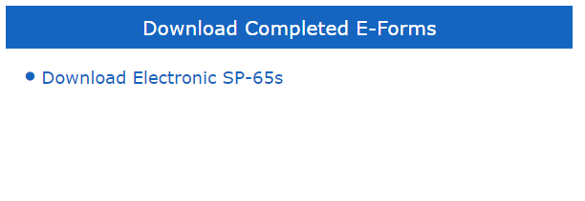
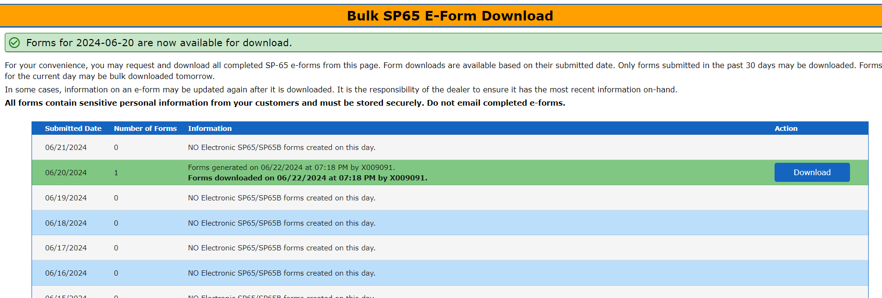
A recent enhancement allows Sellers to download an entire month worth of Electronic SP-65, by clicking on the hyperlink. PFD downloads will be in the form of a compressed ZIP file, which makes file storage idea.
The name of ZIP folder will be the creation date of the electronic SP-65s. Each individual creation date will trigger a new compressed ZIP file, but all electronic SP-65s will be included in that folder.

Slide 13
Thank You.

