Slide 1



Session 5
  Observation of the Eyes and Additional Tests for Drug Impairment

Slide 2
Learning Objectives
  State purposes of eye examinations
  Administer LOC test
  Describe the difference in pupil size
  Administer Modified Romberg Balance test
  Administer Finger-to-Nose test
  Explain relationship between eye examinations and seven drug categories

Slide 3
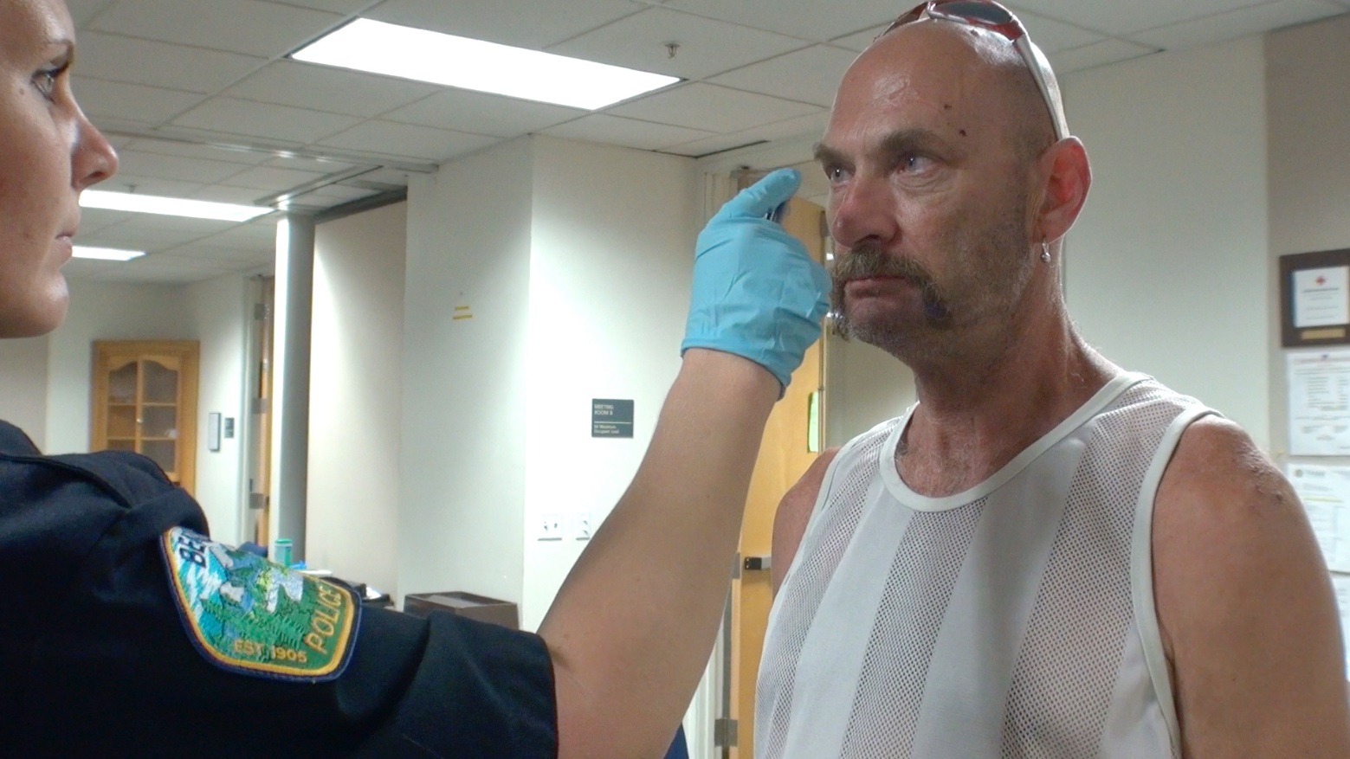
Eye Examinations

Slide 4
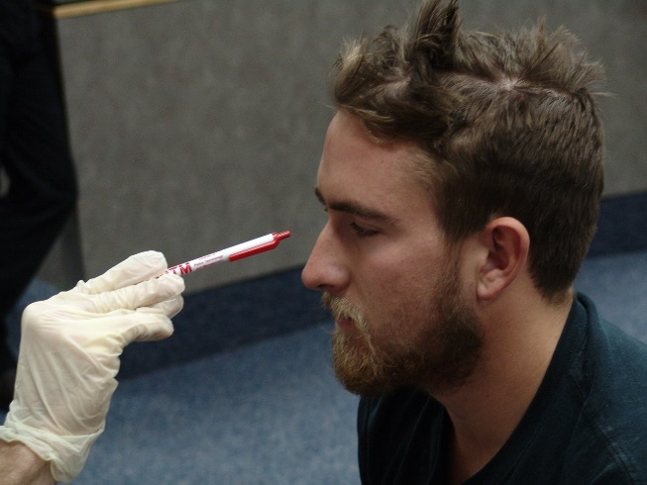
Lack of Convergence
The inability of the person’s eyes to converge or cross as the person attempts to focus on a stimulus as it is pushed towards the bridge of the nose.

Slide 5
Lack of Convergence
Testing Procedure
Examiner
Subject

Slide 6
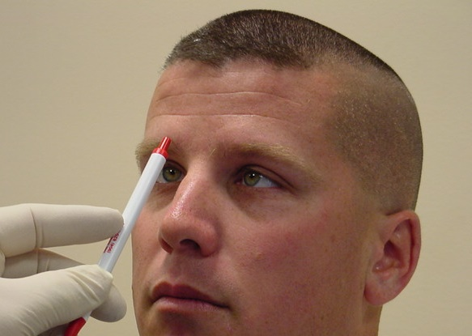
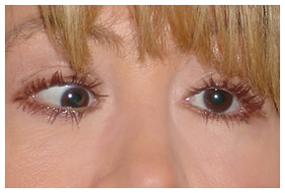
Normal convergence is a distance approximately two inches (2”) from bridge of nose

Slide 7
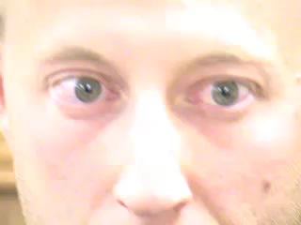
Lack of Convergence

Slide 8
Lack of Convergence Examples

Slide 9
Drug Categories That Usually Cause Lack of Convergence
  CNS Depressants
  Inhalants
Dissociative Anesthetics
Cannabis

Slide 10
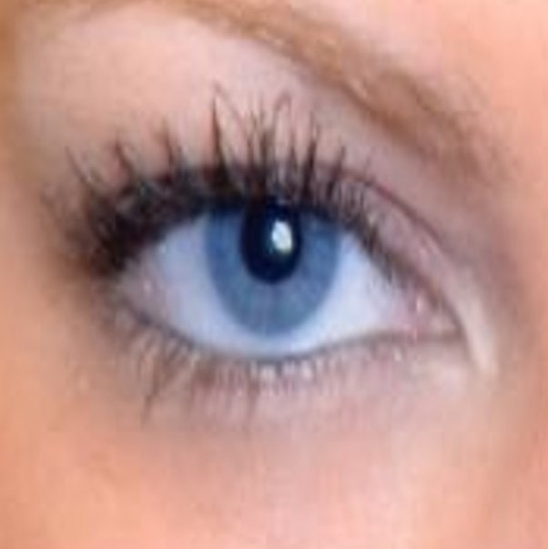
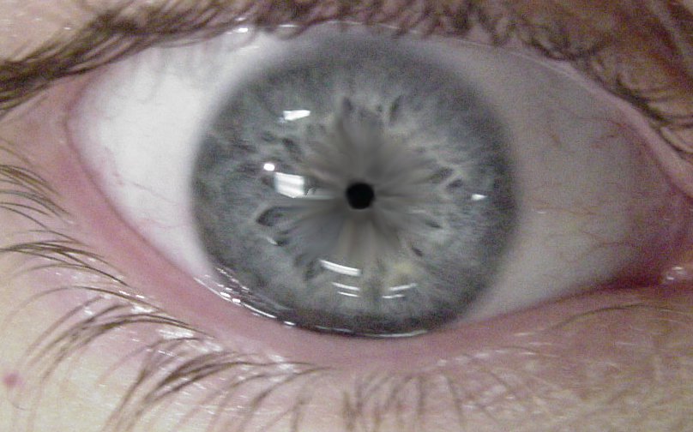
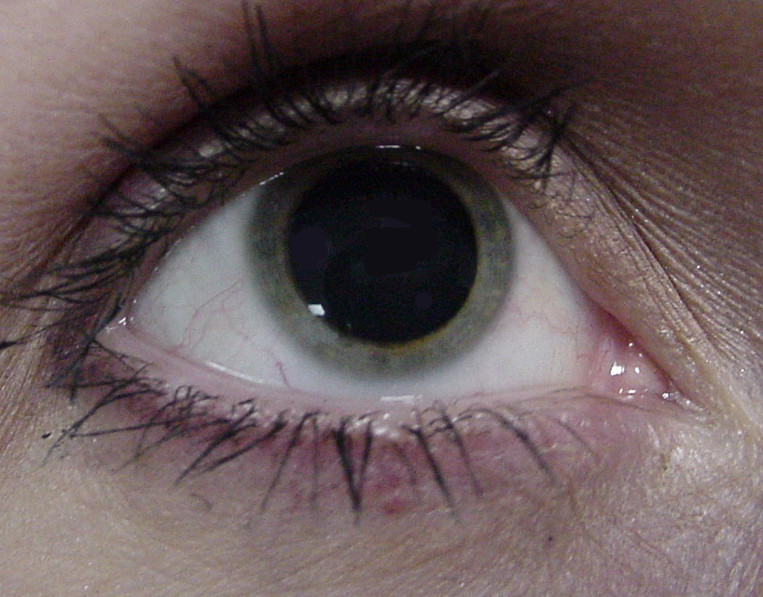
Pupil Size Observations
Dilated
Normal
Constricted

Slide 11

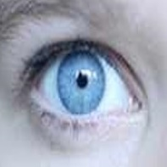
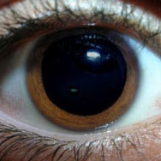
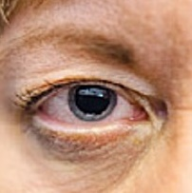
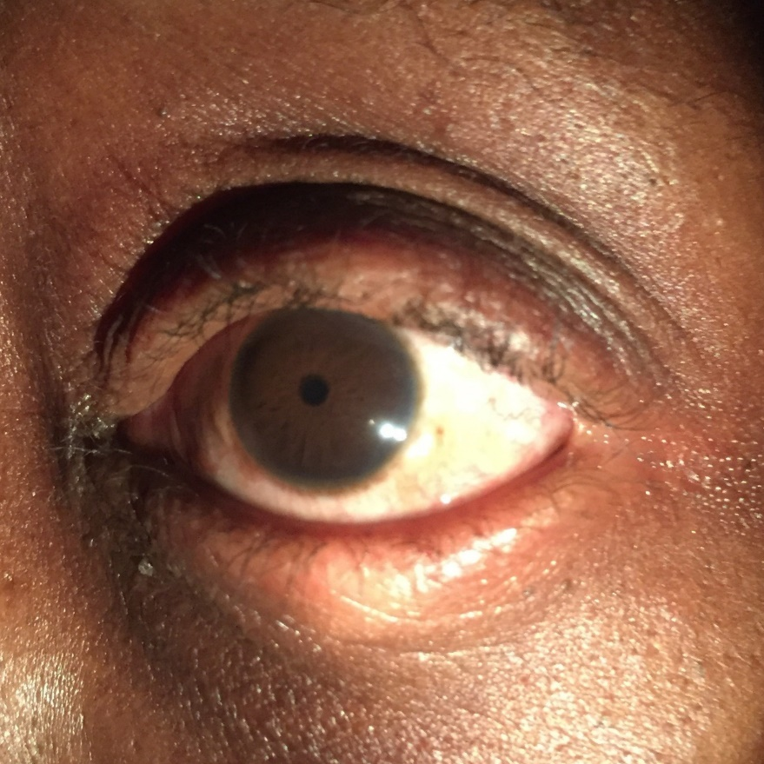
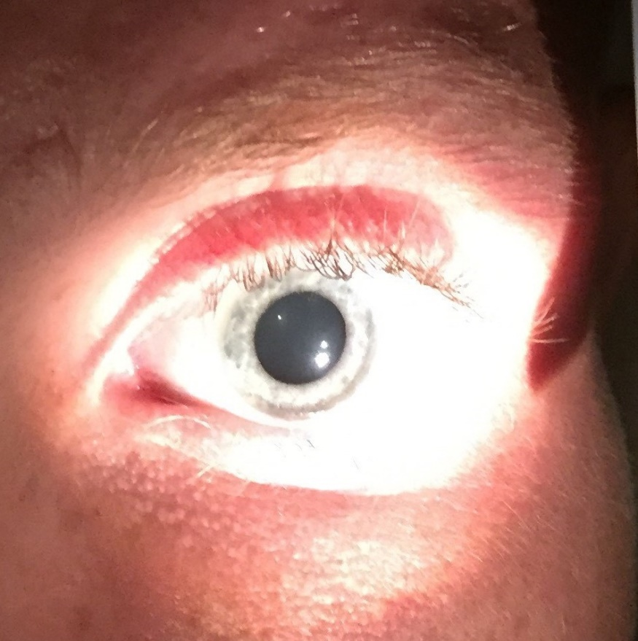
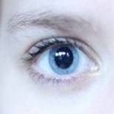
Pupil Observations
Dilated
Normal
Constricted

Slide 12
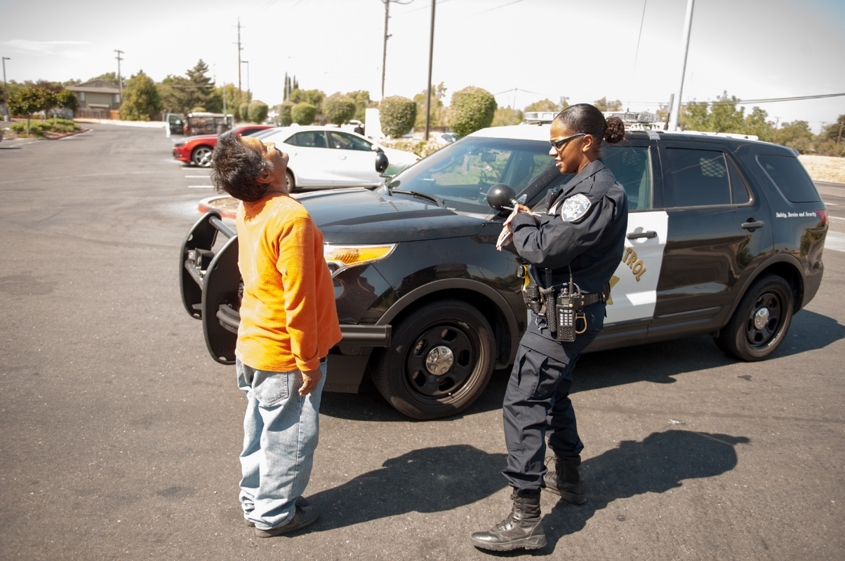
Modified Romberg Balance Test
  Divided attention
  Time estimation

Slide 13

Stages of
Modified Romberg Balance Test
Instruction stage
Balancing stage

Slide 14
Test Interpretation and Documentation
Front-to-Back Sway
Side-to-Side Sway
1-2 Inches
1-2 Inches
1-2 Inches
1-2 Inches

Slide 15
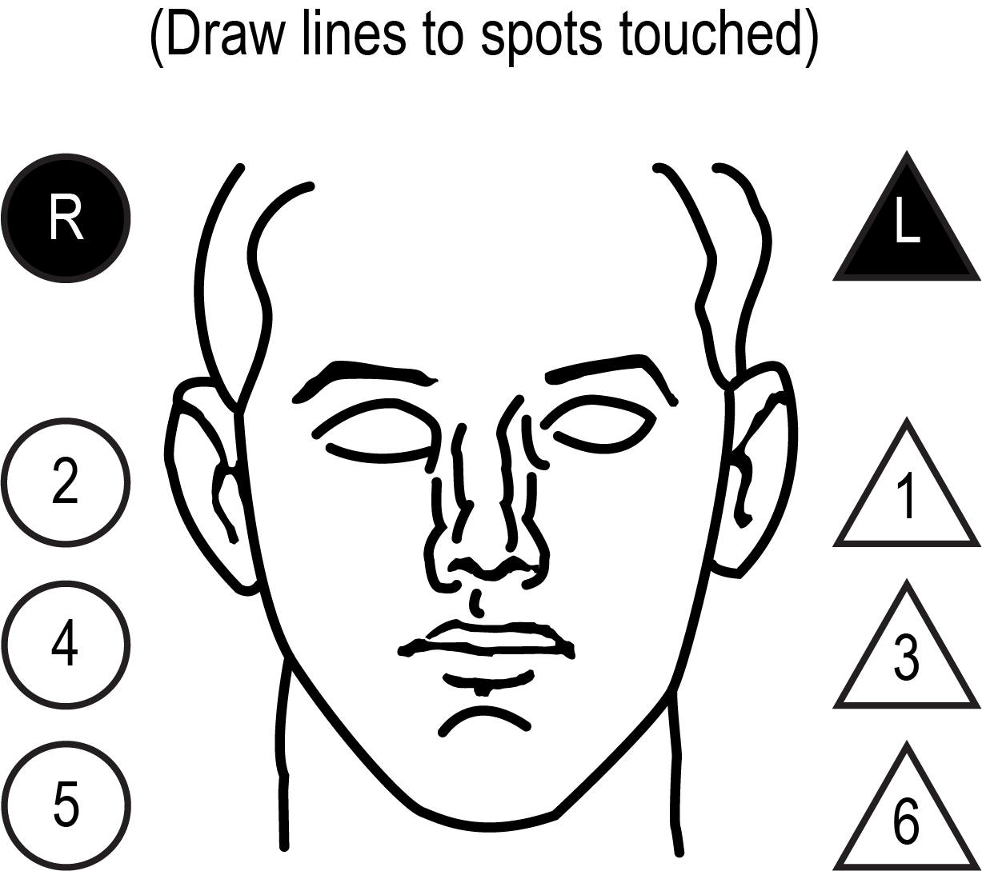
Finger-to-Nose Test
Administrative Procedures
Order:
L, R, L, R, R, L

Slide 16
Finger-to-Nose Test
Recording Results
Order:
L, R, L, R, R, L
P
P

Slide 17
Finger-to-Nose Test Interpretation

Slide 18
Relationships to the Categories
 | CNS Dep. | CNS Stim. | Hall. | Dissoc. Anest. | Narc. Analg. | Inhalant | Cannabis
HGN | Present | None | None | Present | None | Present | None
VGN | Present | None | None | Present | None | Present | None
LOC | Present | None | None | Present | None | Present | Present
Pupil Size | Normal * | Dilated | Dilated | Normal | Constricted | Normal ** | Dilated ***
*Soma, Quaaludes, and some antidepressants usually dilate pupils
**May be dilated
***May be normal

Slide 19
Questions?

