Slide 1
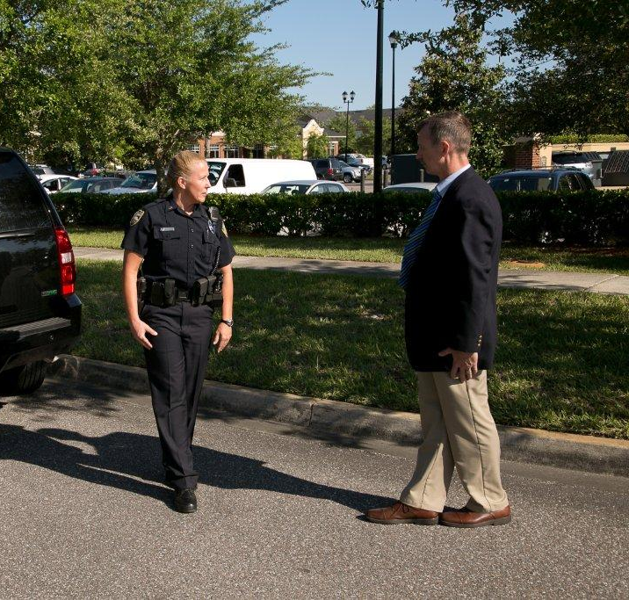



Session 8
Concepts and Principles of the Standardized Field Sobriety Tests (SFSTs)

Slide 2

Learning Objectives
  Discuss development and validity of research and standardized elements, clues, and interpretation of
  the three SFSTs
  Discuss different types of nystagmus and their effects on HGN test

Slide 3
Learning Objectives
Discuss and properly administer the three SFSTs
Discuss and properly recognize clues of the three SFSTs
Describe and properly record results of the three SFSTs on standard note-taking guide
Identify limitations of the three SFSTs

Slide 4
Overview:
Development and Validation
NHTSA research began in 1975 in California
Three final reports published
  California: 1977 (lab study only)
  California: 1981 (lab/field study)
  Maryland, Washington, DC, Virginia,
  North Carolina: 1983 (field study only)

Slide 5
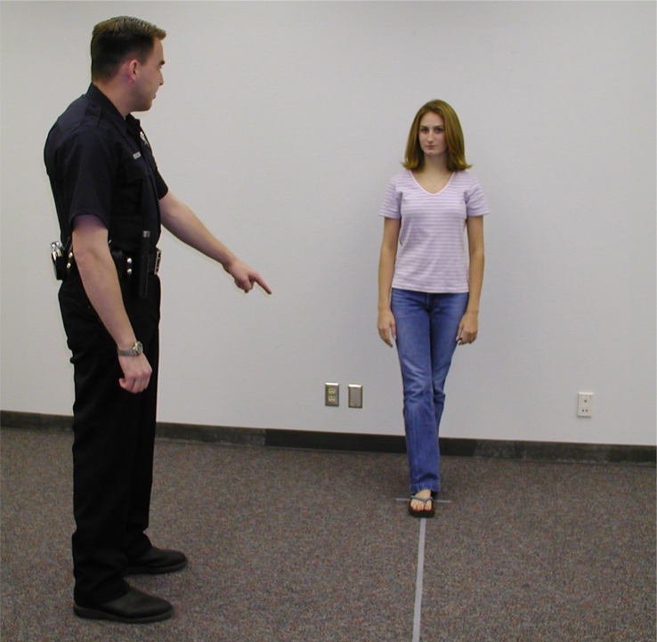
Original Research Objectives

Slide 6

Volunteers Were Subjected to Six Tests
One Leg Stand
Finger-to-Nose
Finger Count
Walk and Turn
Tracing
Nystagmus

Slide 7
Original SCRI Test Data Results

Slide 8
Third Phase: Field Validation and Standardization Objectives
Standardized, practical, and effective procedures
Determine feasibility of procedures in enforcement conditions
Determine if tests discriminate in field as well as in laboratory

Slide 9

Standardized Elements
Administrative Procedures
Clues
Criteria

Slide 10
Importance of Large Scale
Field Validation Study
First significant assessment of workability under actual enforcement conditions
First time completely objective clues and recording criteria had been defined for tests
Results of study validated SFSTs

Slide 11
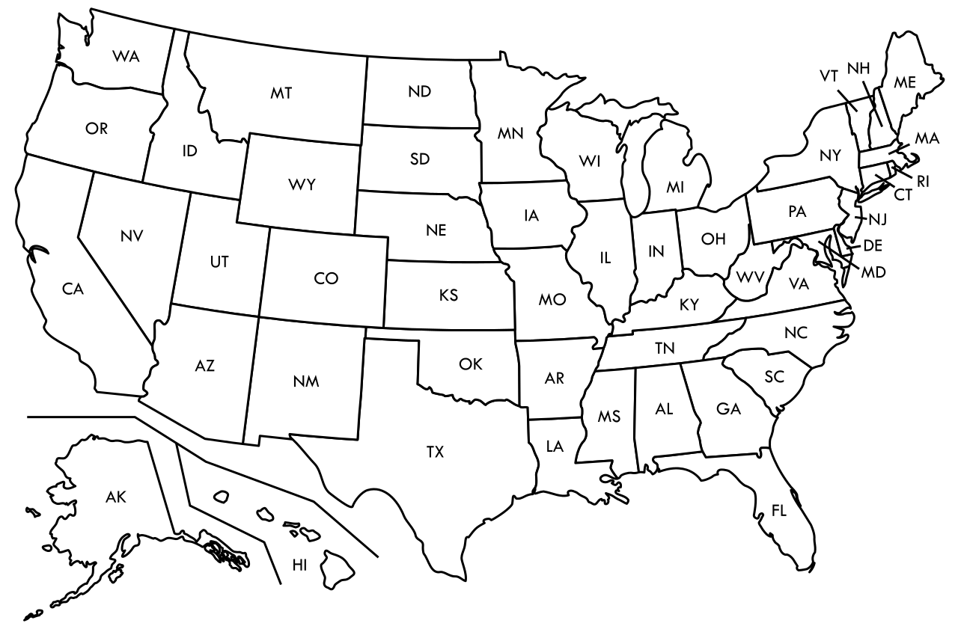
SFST Field Validation Studies

Slide 12
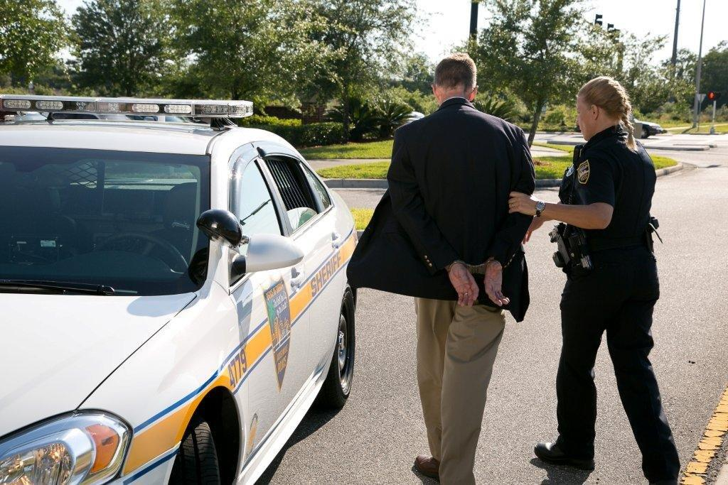
“Correct” and “Incorrect”
Arrest Decisions

Slide 13
Colorado Field Validation
Study of SFST
First full field validation study using SFST-experienced law enforcement
86% correct arrest/release decision based on three SFSTs
93% of those arrested had a BAC of 0.05 or higher

Slide 14
Florida Field Validation
Study of SFST
95% correct arrest decision based on three SFSTs
Validated SFSTs at 0.08 BAC and above

Slide 15
San Diego Field Validation
Study of SFST
91% correct-arrest decision for 0.08 BAC and above using three SFSTs
HGN is still most reliable of three SFSTs and supports arrest decisions at 0.08 BAC

Slide 16
San Diego Field Validation
Study of SFST

Slide 17
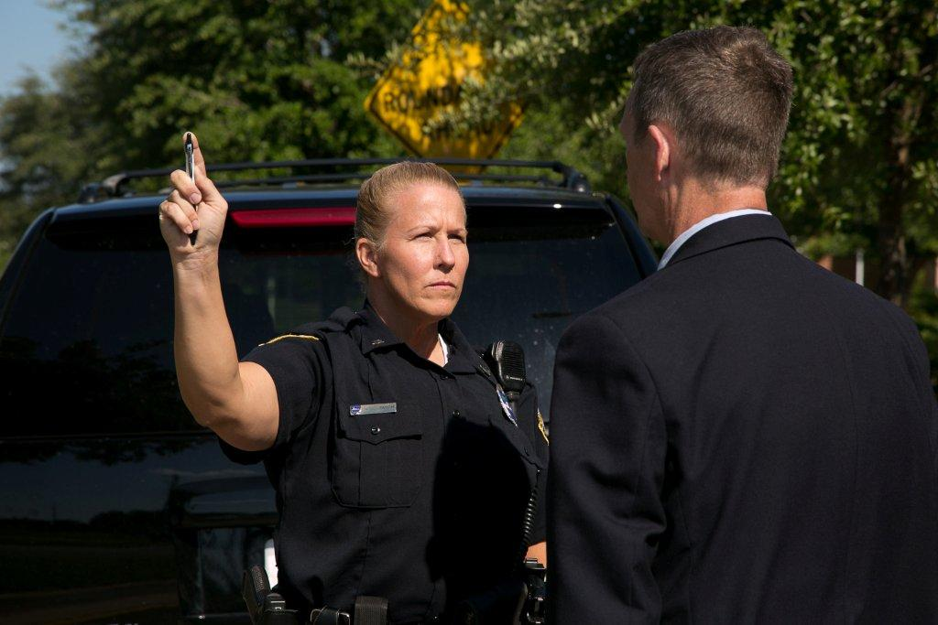
Horizontal Gaze Nystagmus
Involuntary jerking of eyes,
occurring as eyes gaze to the side

Slide 18
Categories of Nystagmus
Vestibular
Neural
Pathological Disorders and Diseases

Slide 19
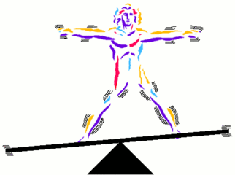
Vestibular Nystagmus
Rotational
Post Rotational
Caloric
Positional Alcohol Nystagmus

Slide 20
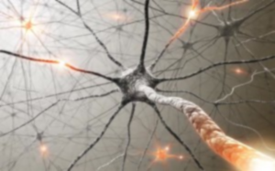
Neural Nystagmus
Optokinetic
Physiological
Gaze

Slide 21

Gaze Nystagmus
    Horizontal
    Vertical
    Resting

Slide 22

Horizontal Gaze Nystagmus
Involuntary jerking of eyes, occurring as eyes gaze
to side

Slide 23
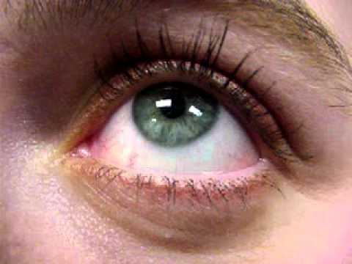
Vertical Gaze Nystagmus
Involuntary jerking of eyes (up and down)

Slide 24
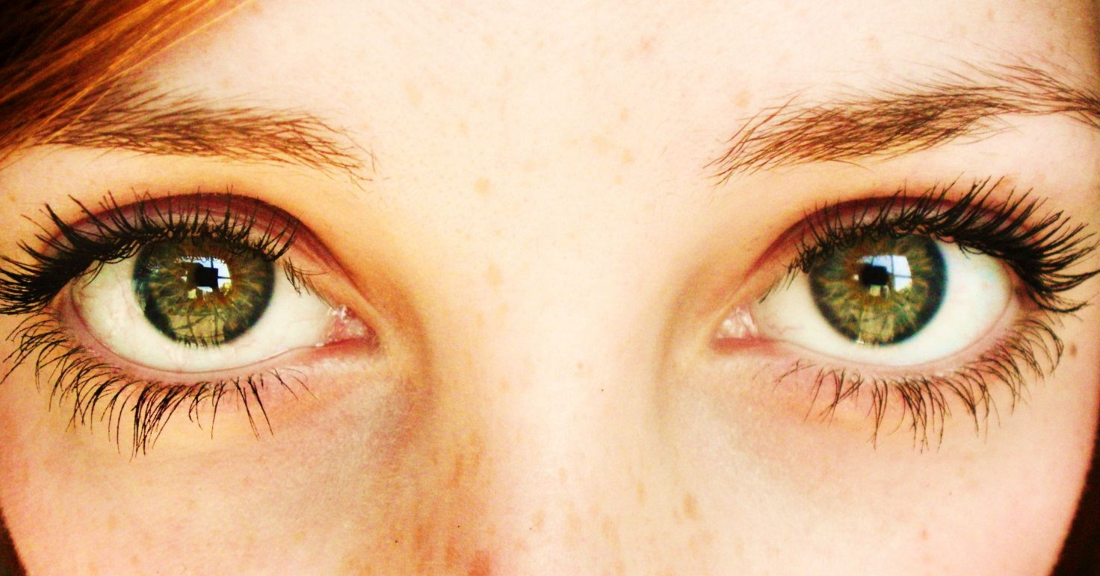
Resting Nystagmus
Jerking of eyes as they look straight ahead

Slide 25
Pathological Disorder Nystagmus
Brain tumors and other brain damage
Some inner ear diseases
Rare in the driving population

Slide 26
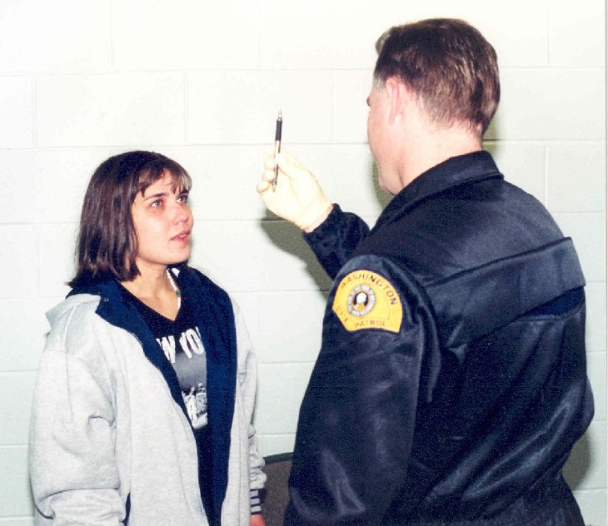
Medical Impairment
Even though the possibility of alcohol and/or drug impairment exists, be aware of medical conditions having symptoms in common with alcohol influence.

Slide 27
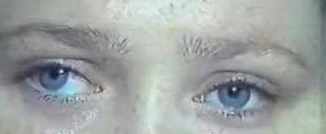
Horizontal Gaze Nystagmus Medical Impairment
Assessment Procedures
Check eyes for:
Equal Pupil Size
Resting Nystagmus
Equal Tracking

Slide 28
Horizontal Gaze Nystagmus Testing: Three Clues
Lack of Smooth Pursuit
Distinct and Sustained Nystagmus at
Maximum Deviation
Onset of Nystagmus Prior to 45 Degrees

Slide 29
Administrative Procedures
Check for eyeglasses
Verbal instructions
Position stimulus (12-15 inches and slightly above eye level)
Check for Equal Pupil Size and Resting Nystagmus
Check for Equal Tracking

Slide 30
Administrative Procedures
Lack of Smooth Pursuit
Distinct and Sustained Nystagmus at
Maximum Deviation
Onset of Nystagmus Prior to 45 Degrees
Total the clues
Check for Vertical Nystagmus

Slide 31
Horizontal Gaze Nystagmus Procedures
Check for eyeglasses
Verbal instructions
Position stimulus

Slide 32
Horizontal Gaze Nystagmus Procedures
Equal Pupil Size and Resting Nystagmus
Equal Tracking

Slide 33
Horizontal Gaze Nystagmus Procedures
Check for Lack of Smooth Pursuit
Check for Distinct and Sustained Nystagmus at Maximum Deviation
Check for Onset of Nystagmus Prior to 45 Degrees

Slide 34
Horizontal Gaze Nystagmus Procedures
Total the clues
Check for Vertical Gaze Nystagmus

Slide 35
Test Interpretation
Look for three clues of nystagmus in each eye:
Lack of Smooth Pursuit
Distinct and Sustained Nystagmus at Maximum Deviation
Onset of Nystagmus Prior to 45 Degrees

Slide 36
Three Clues of Horizontal Gaze Nystagmus
Lack of Smooth Pursuit
Distinct and Sustained Nystagmus at Maximum Deviation
Onset of Nystagmus Prior to 45 Degrees

Slide 37
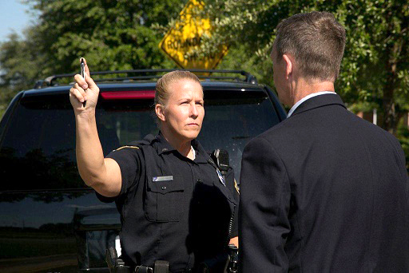
Clue Number 1
Lack of Smooth Pursuit

Slide 38

Clue Number 1
Lack of Smooth Pursuit

Slide 39
Mechanics of Clue Number 1
Move object steadily at a speed
that takes approximately 2 seconds
to bring the eye from center to side

Slide 40
Clue Number 2
Distinct and Sustained Nystagmus
at Maximum Deviation

Slide 41
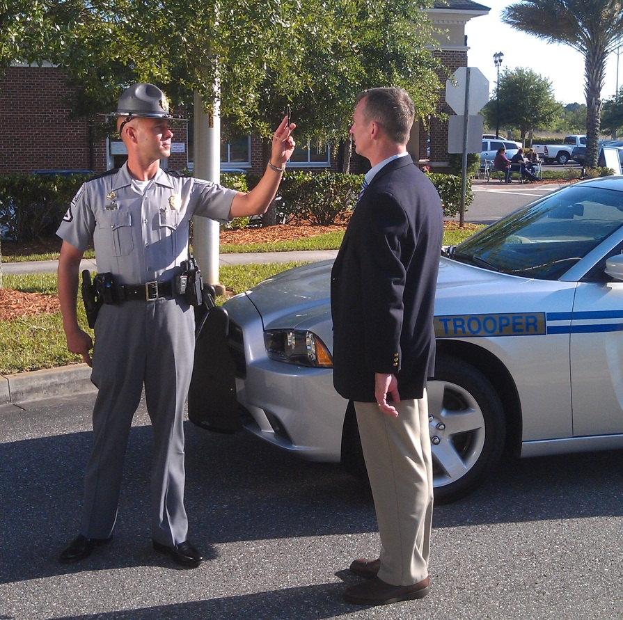
Clue Number 2
Distinct and Sustained Nystagmus
at Maximum Deviation

Slide 42
Clue Number 3
Onset of Nystagmus Prior to 45 Degrees

Slide 43
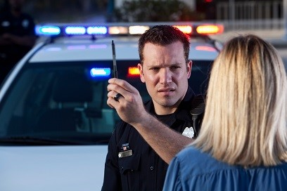
Clue Number 3
Onset of Nystagmus Prior to 45 Degrees

Slide 44

Mechanics of Clue Number 3

Slide 45
45 Degree Template
45
o

Slide 46
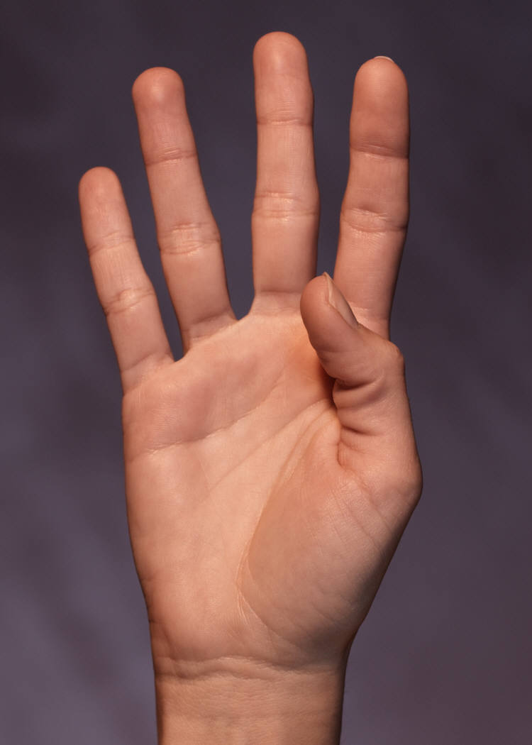
Horizontal Gaze Nystagmus Test Criterion
4 or more clues indicates
BAC above 0.08 (88% accurate)

Slide 47
Administrative Procedures
Check for eyeglasses
Verbal instructions
Position stimulus (12-15 inches and slightly above eye level)
Check for Equal Pupil Size and Resting Nystagmus
Check for Equal Tracking

Slide 48
Administrative Procedures
Lack of Smooth Pursuit
Distinct and Sustained Nystagmus as Maximum Deviation
Onset of Nystagmus Prior to 45 Degrees
Total the clues
Check for Vertical Nystagmus

Slide 49
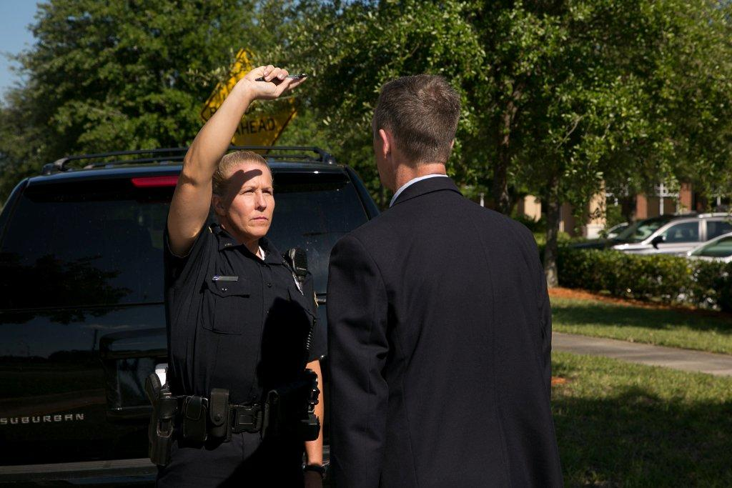
Vertical Gaze Nystagmus

Slide 50
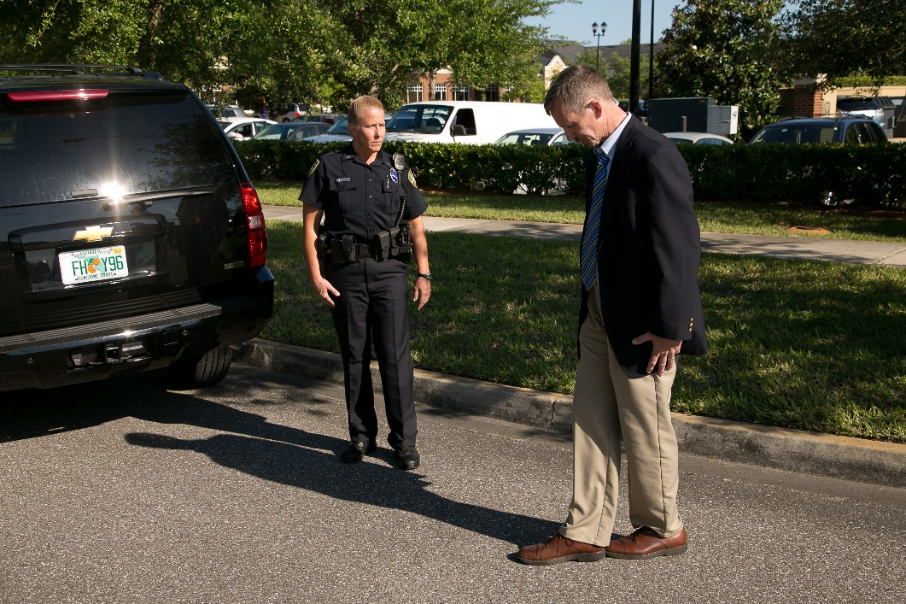
Walk and Turn
Divided Attention Test
Mental Task and Physical Task
Instruction stage
Walking stage

Slide 51
Safety Precautions

Slide 52
Administrative Procedures
Instruction Stage
Verbal Instructions
  Assume heel-to-toe stance
  Arms down at sides
  Don’t start until told

Slide 53
Administrative Procedures
Walking Stage
Nine heel-to-toe steps, turn, nine heel-to-toe steps
Turn procedures:
  Turn around on the line
  Several small steps

Slide 54
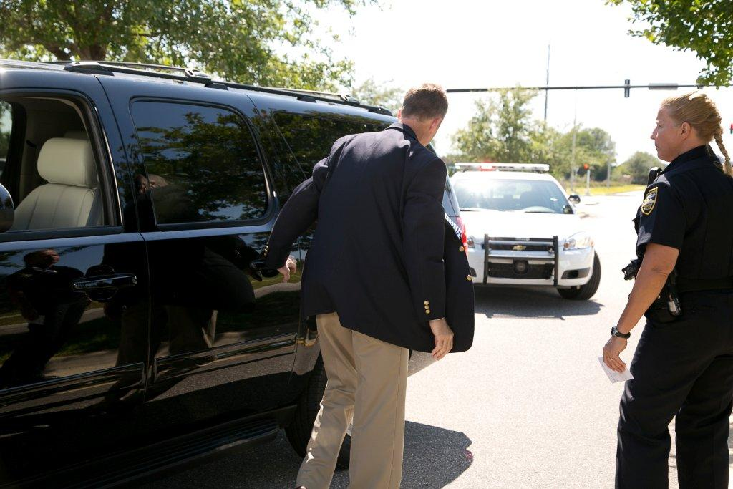
Instruction Stage Clues
Cannot keep balance while listening to instructions
Starts too soon

Slide 55
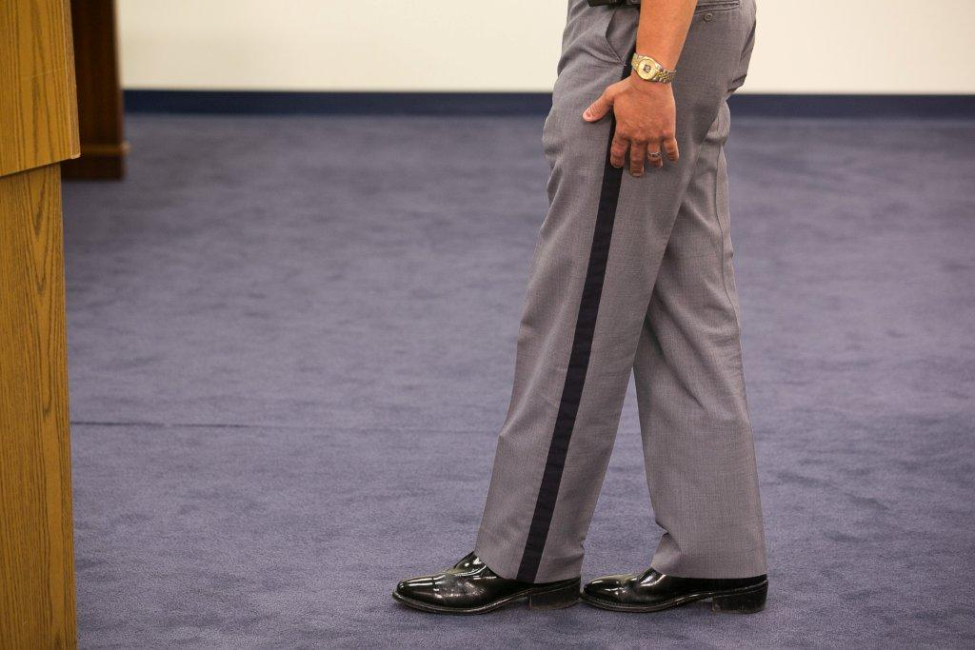
Walking Stage Clues
Stops while walking
Does not touch heel-to-toe
Steps off the line
Uses arm(s) to balance
Improper turn
Incorrect number of steps

Slide 56
Walk and Turn Test Clues Summary
SFSTs are a tool to assist you in seeing visible signs of impairment and are not a pass/fail test.

Slide 57
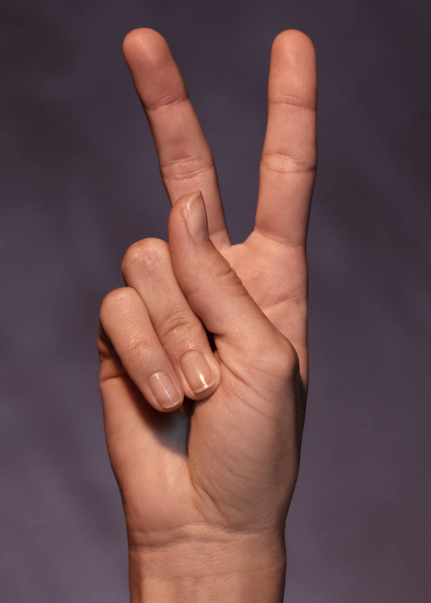
Walk and Turn Test Criterion
2 or more clues indicates BAC
at or above 0.08 (79% accurate)

Slide 58
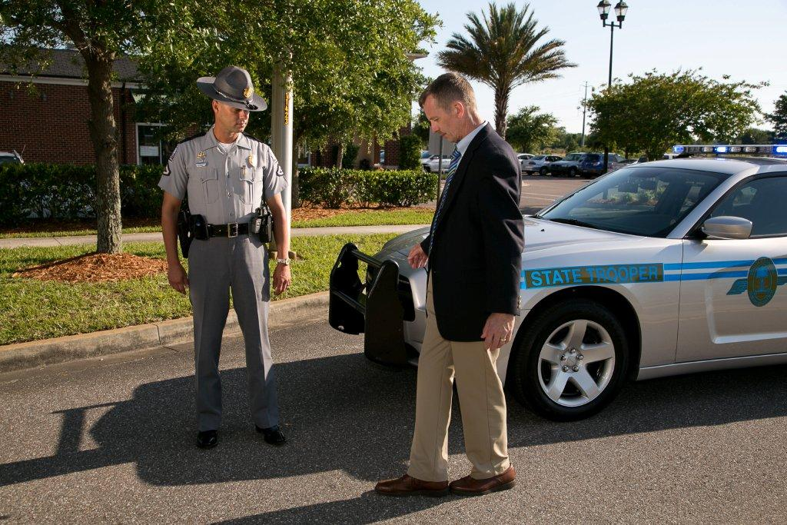
Walk and Turn Test Demonstration

Slide 59
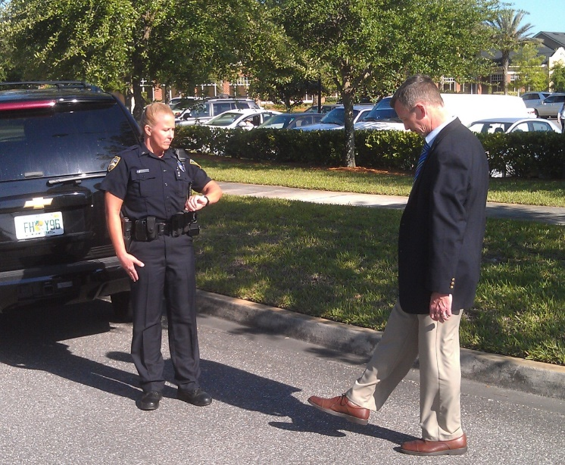
One Leg Stand
Divided Attention Test
Mental Task and Physical Task
Instruction stage
Balance and counting stage

Slide 60
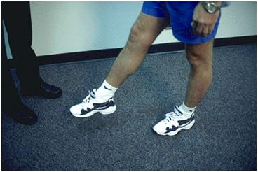
Administrative Procedures
Instruction Stage
  Stand straight, feet together
  Keep arms at sides
  Maintain position until told otherwise

Slide 61
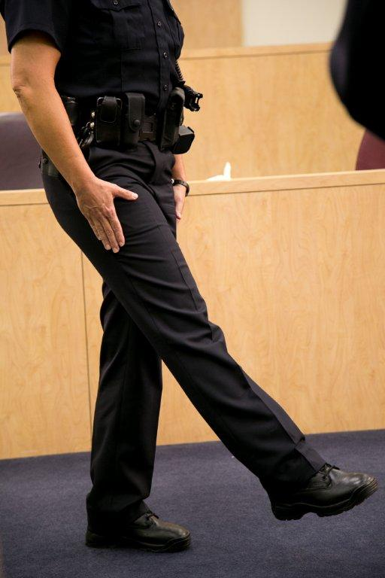
Administrative Procedures
Balance and Counting Stage

Slide 62
One Leg Stand Test Clues
Sways while balancing
Uses arm(s) to balance

Slide 63
One Leg Stand Test Clues
Hopping
Puts foot down

Slide 64
One Leg Stand Test Criterion
2 or more clues indicates BAC
at or above 0.08 (83% accurate)

Slide 65
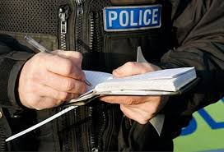
Taking Field Notes on the SFSTs

Slide 66
Medical Assessment
Equal Pupils Yes No
Equal Tracking Yes No
Resting Nystagmus Yes No
Other __________________________________

Slide 67
Horizontal Gaze Nystagmus
LEFT | RIGHT
Lack of a smooth pursuit
Distinct and sustained Nystagmus at max dev
Onset of Nystagmus prior to 45 degrees

Slide 68
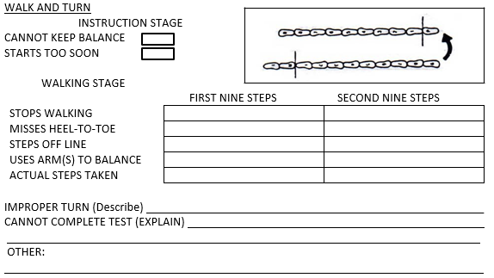
Walk and Turn

Slide 69
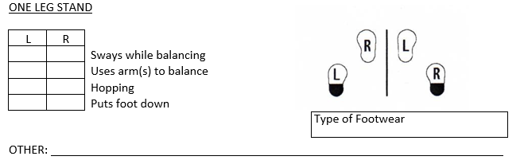
One Leg Stand Field Notes

Slide 70
Questions?

Slide 71
Test Your Knowledge
WAT is an example of a _____ -attention field sobriety test.
The WAT requires a real or imaginary line, and a reasonably ______, non-slippery surface.
During the _____ stage of the WAT, the subject is required to count their steps out loud.

Slide 72
Test Your Knowledge
Based upon the San Diego study, the WAT test can determine whether a subject’s BAC is above or below 0.08, _____ % of the time
In the WAT test, a subject who steps off the line during the first 9 steps and once again during the second 9 steps and who uses arm(s) to balance twice during the second 9 steps has produced _____ distinct clue(s).

Slide 73
Test Your Knowledge
The WAT test has ____________ possible clues.
During the _____ stage of the OLS test the subject must maintain balance while standing on one foot
The OLS test requires the subject keep the foot raised for _____ seconds.

Slide 74
Test Your Knowledge
Based upon the San Diego study, the OLS test can determine whether a subject’s BAC is above or below 0.08, _____ % of the time
In the OLS test, a subject who sways has produced _____ clue(s)
In the OLS test, a subject who uses arm(s) to balance, is hopping, and puts foot down has produced _____ clue(s).

Slide 75
Test Your Knowledge
The maximum number of clues for HGN that can appear in one eye is_____.
Based upon the San Diego study, the HGN test can determine whether a subject’s BAC is above 0.08, _____ % of the time.
The third clue of HGN is an Onset of Nystagmus Prior to _____ Degrees.

