Slide 1
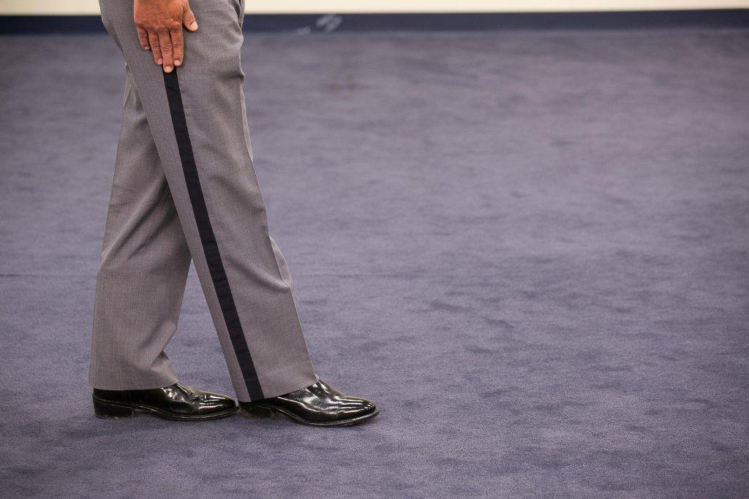
Session 9
SFST Demonstrations and Practice

Slide 2
Learning Objective
Demonstrate appropriate administrative procedures for SFSTs

Slide 3
Instructor-Led Presentation
Three tests:
HGN and VGN
WAT
OLS

Slide 4
Procedures and Group Assignments
Practice procedures
HGN and VGN
WAT
OLS
Participants record each other’s performance

Slide 5
Questions?

