Slide 1
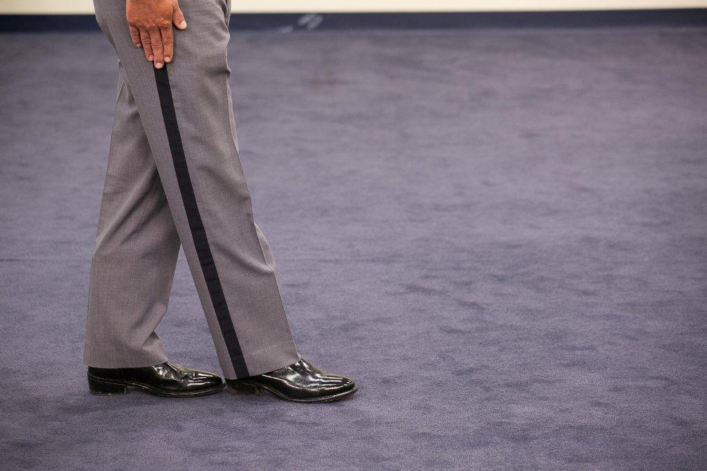
Session 10
Alcohol Workshop: First Session

Slide 2
Learning Objectives
Properly administer SFSTs
Properly observe and record subject’s performance utilizing standard note-taking guide
Properly interpret subject’s performance
Properly use and maintain SFST Log

Slide 3
Procedures
Same teams as dry run
Each team member administers one complete series of tests to at least one drinking volunteer
Prepare descriptive written test record on each volunteer tested
Other team members observe and record performance

Slide 4
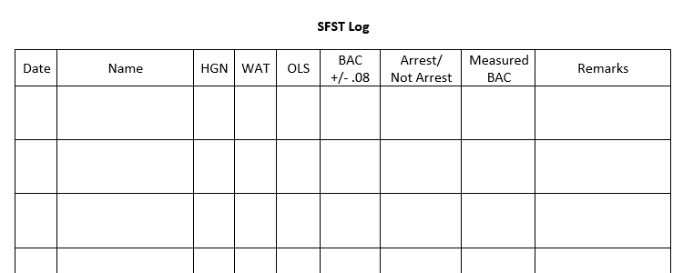
SFST Log

Slide 5
Questions?

